Slide 1

BOC Mobile Banking Application
Group Name : Trojan Horses
Group ID : 2021S2_REG_WE_47

Slide 2
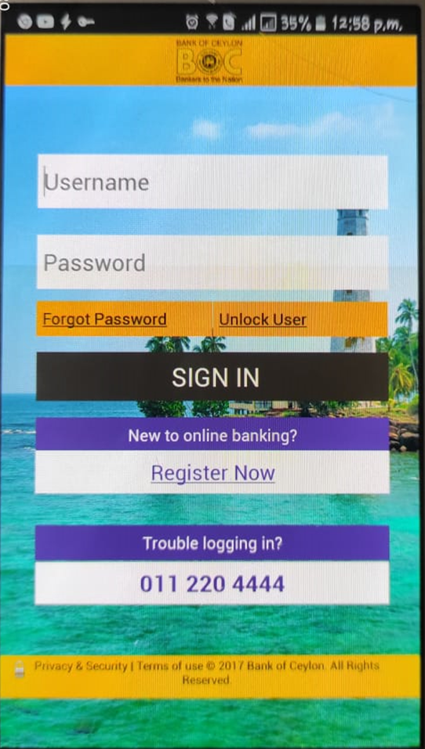
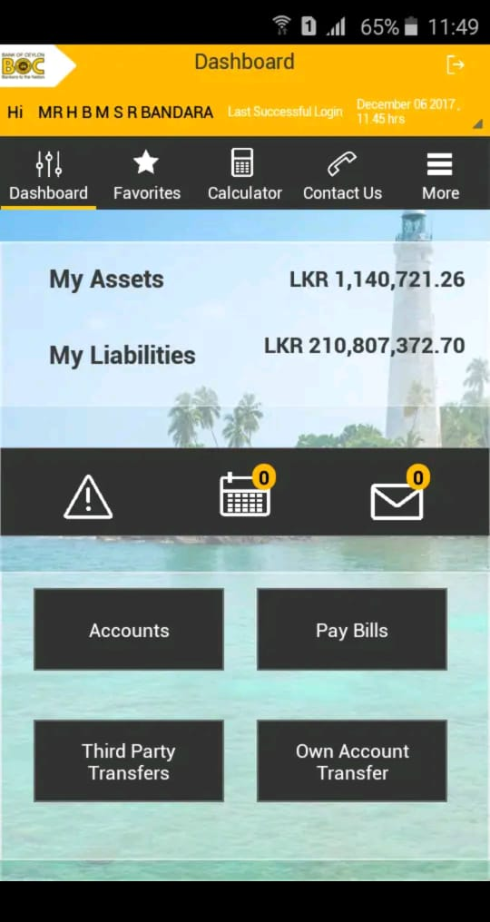
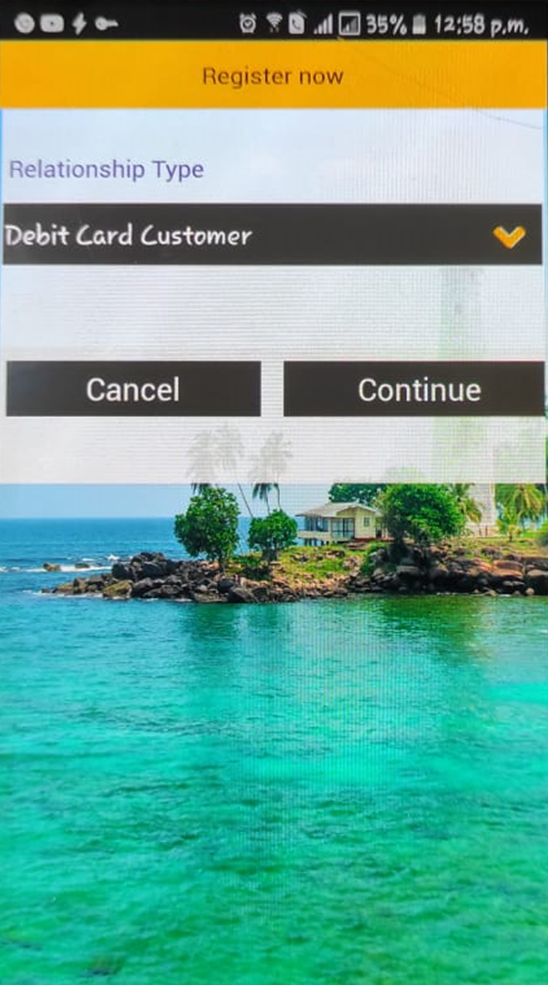

Slide 3
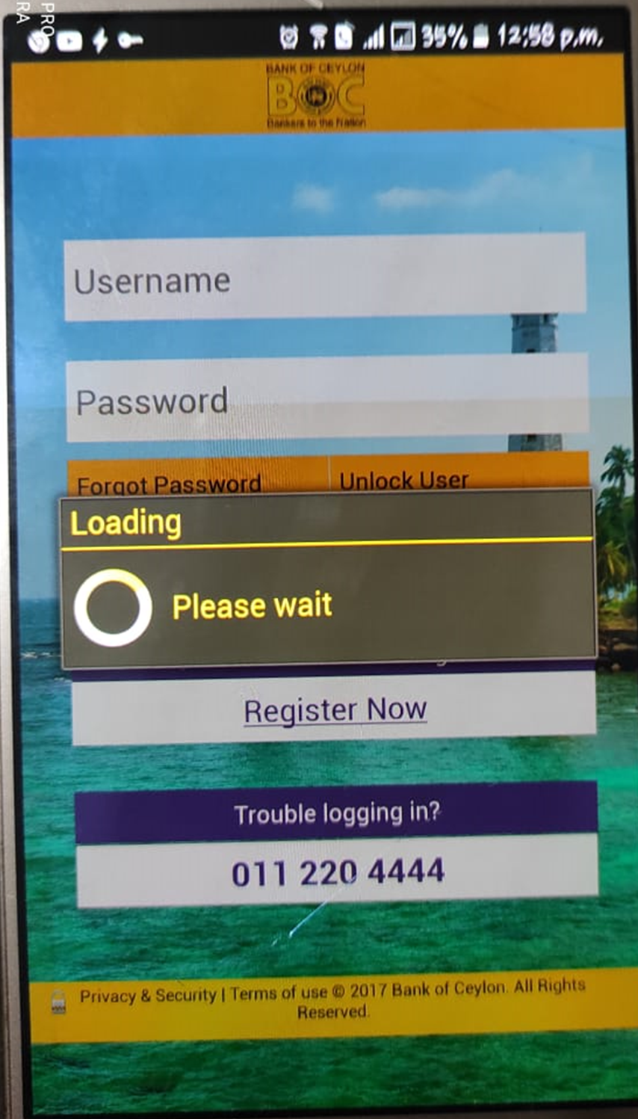
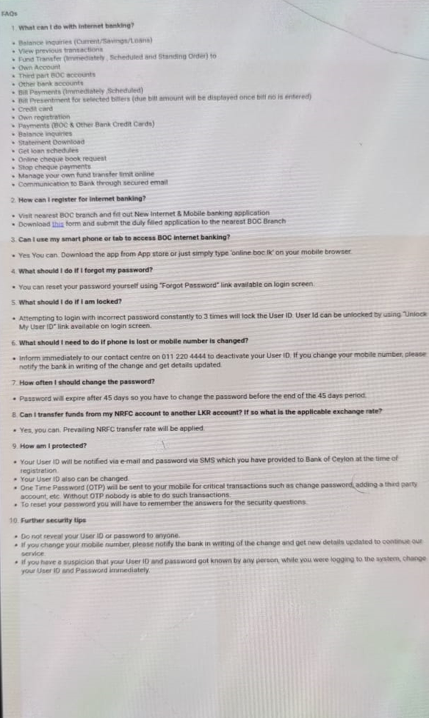

Slide 4
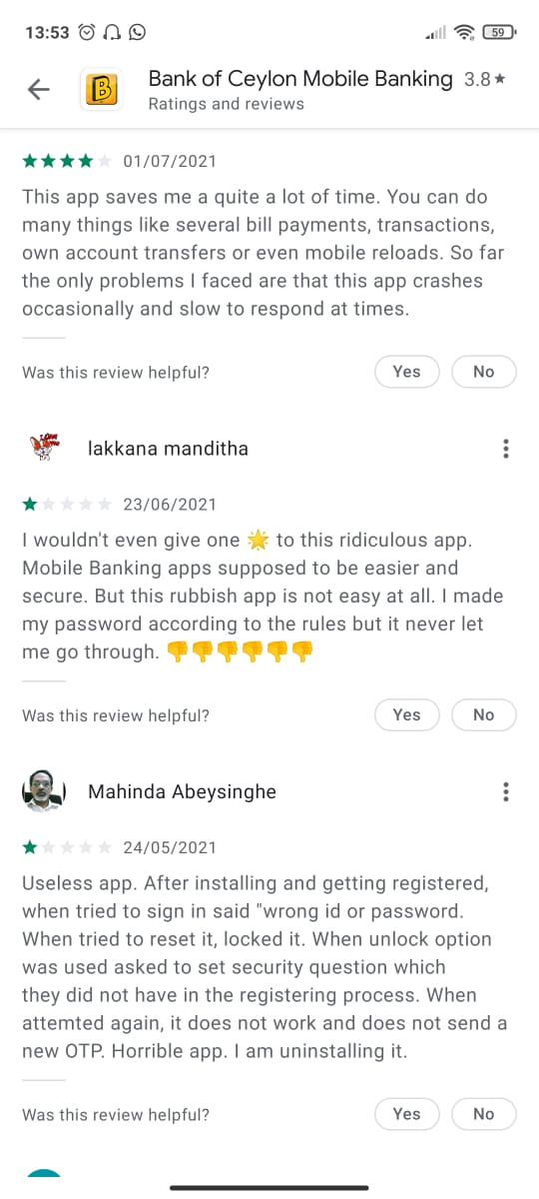
Founded Issues in user reviews
No easy login
Long and complex username.
Passwords not working issues.
The User Interfaces are not user friendly.
Saves contact details on just a page, uneasy to read.
User details are not visible clearly.
Takes long time to load.
Issues in installation

Slide 5
Member | Functions
Member 1 | User Authentication Handle Own account transfers.
Member 2 | View details of account and transactions. Handle credit card payments.
Member 3 | 1. Handle bill payments. 2. View messages and contact details.
Member 4 | Handle third party transfers. Calculate Budget.

